Slide 1
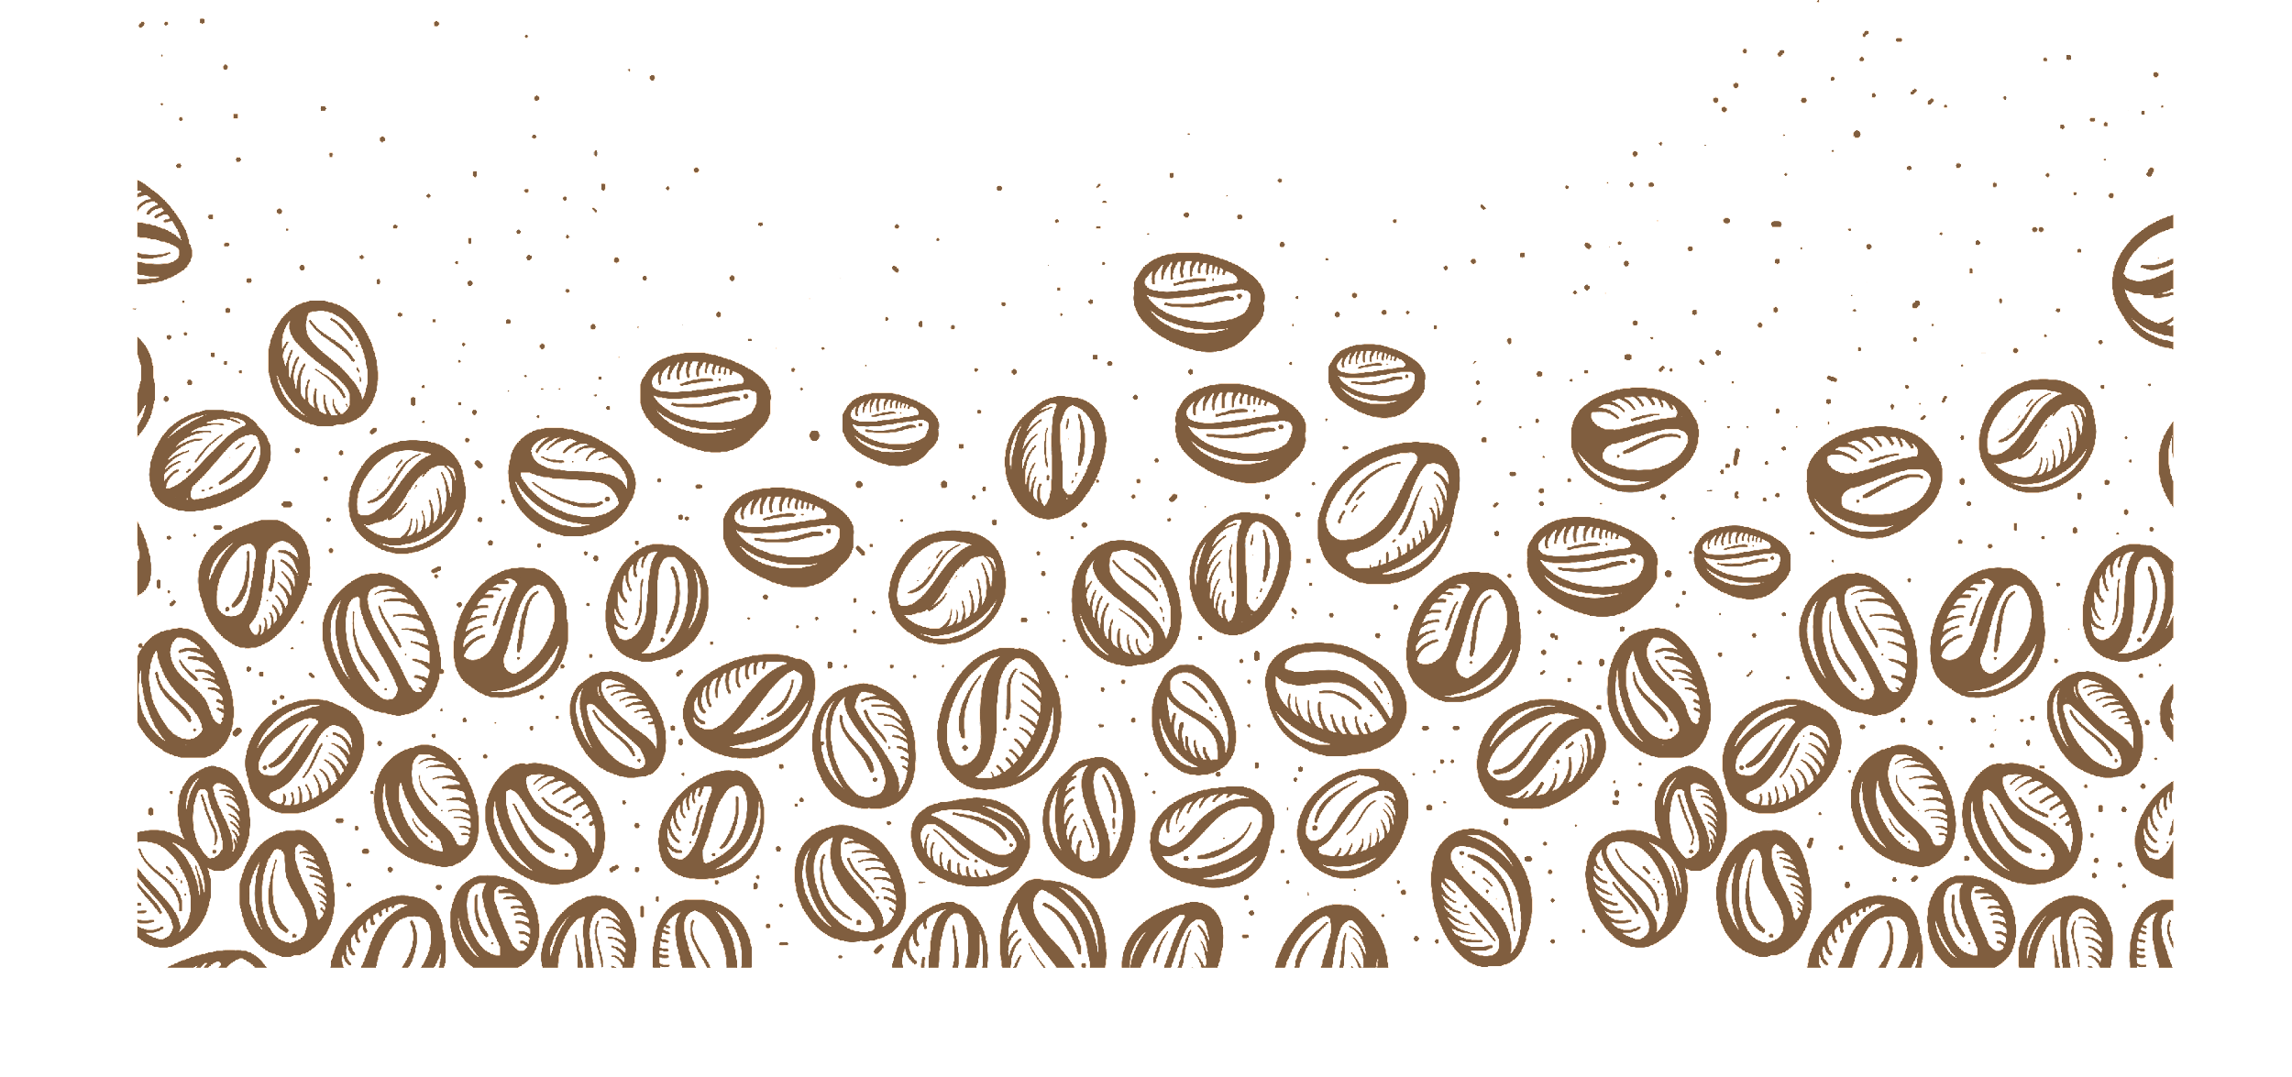

BS 6206 Case Study #1
Customer Segmentation
Group 3: Guo Peihong Chen Yuzhou Cao Ning Huang Bokai

Slide 2
CONTENTS
01. PROBLEM STATEMENT
02. EXPLORATORY DATA ANALYSIS
03. MODELS & RESULTS
04. INSIGHTS
05. NEXT STEP WORK

Slide 3

PART 01
PROBLEM STATEMENT

Slide 4

Objective:
Key Results:
Recommending Hook Coffee’s next physical outlet location according to all informations
1
Describing customer characteristics with 8 features
2
Clustering customers into 5 groups according to important features extracted
3
Finding differences in shopping habits among groups and suggesting marketing strategies

Slide 5
PART 02
EXPLORATORY DATA ANALYSIS

Slide 6
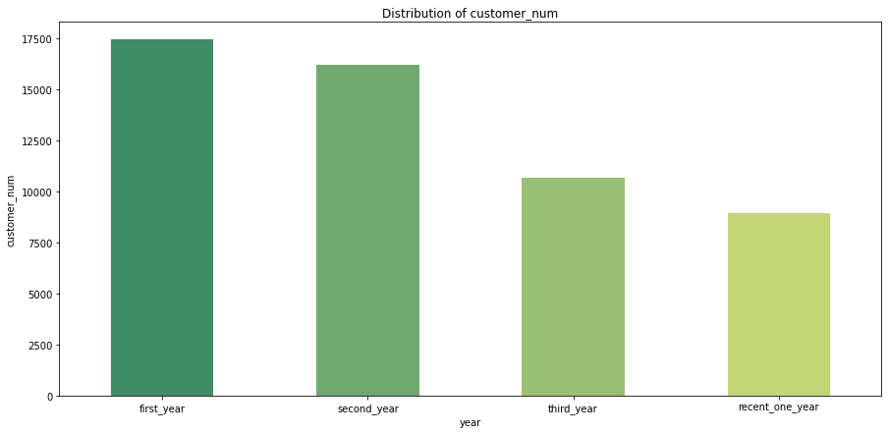
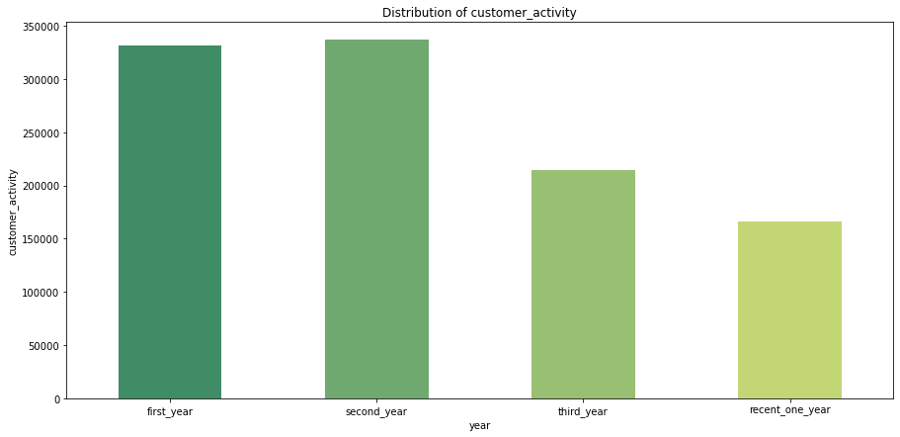
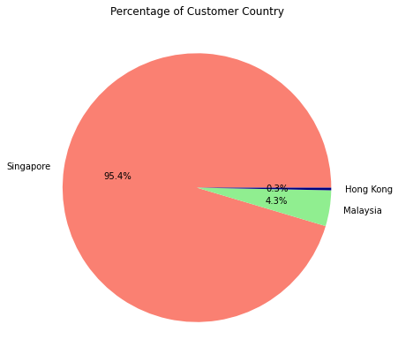
Singapore Customers and Activities: Downward Trend
Years Analysis:
The vast majority of customers are Singaporeans(95.4%)
Customers and activities in the most recent year have shrunk by about half compared to the peak year

Slide 7
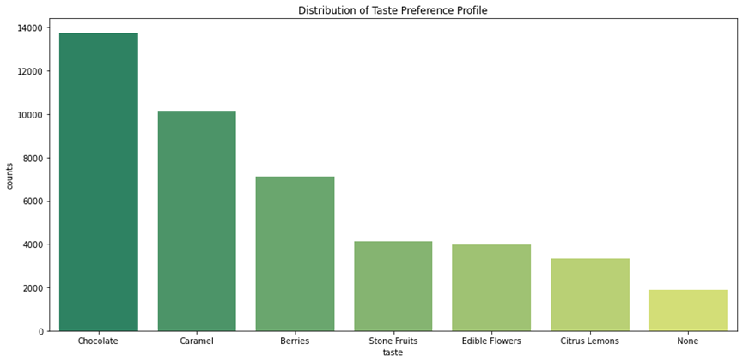
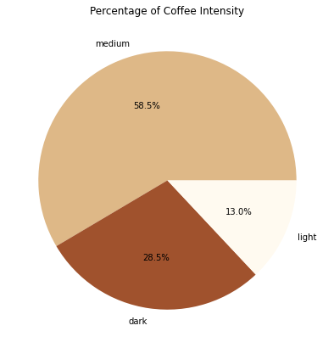
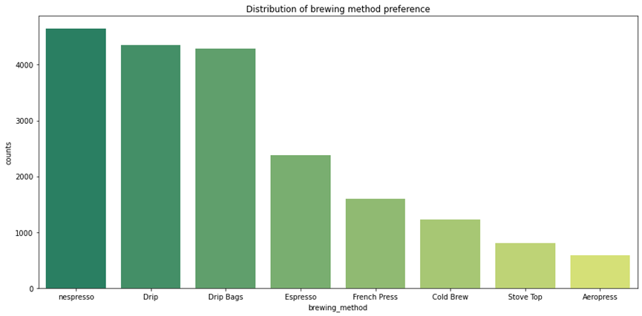
Customer's Choice: Moderation, Tradition and Convenient
Questionnaire Analysis:
Intensity: 58.5% Medium Moderation
Taste: Chocolate & Caramel Tradition
Brewing Method: Nespresso & Drip
Convenient

Slide 8
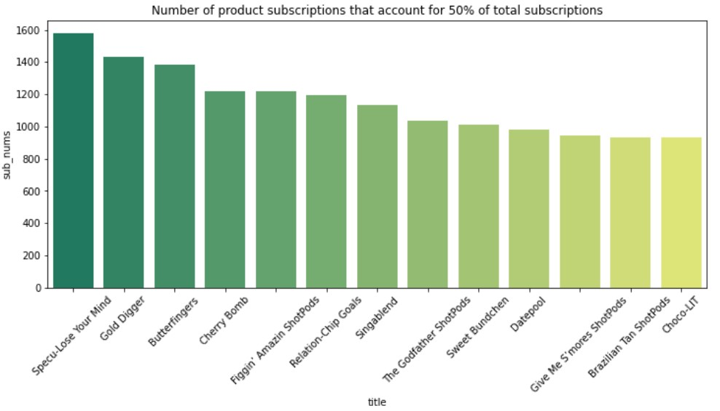

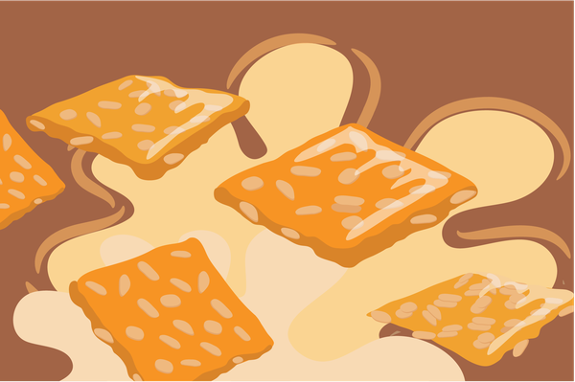
Most Popular Subscriptions: Low Acidity
Subscription Analysis:
13 types of products(11 low acidity, 1 medium and 1 high) accounted for 50% of the total subscriptions
Three most popular products:
Specu-Lose Your Mind(low), Gold Digger(low), Butterfingers(low)
On sale: 17 low, 6 medium, 4 high

Slide 9
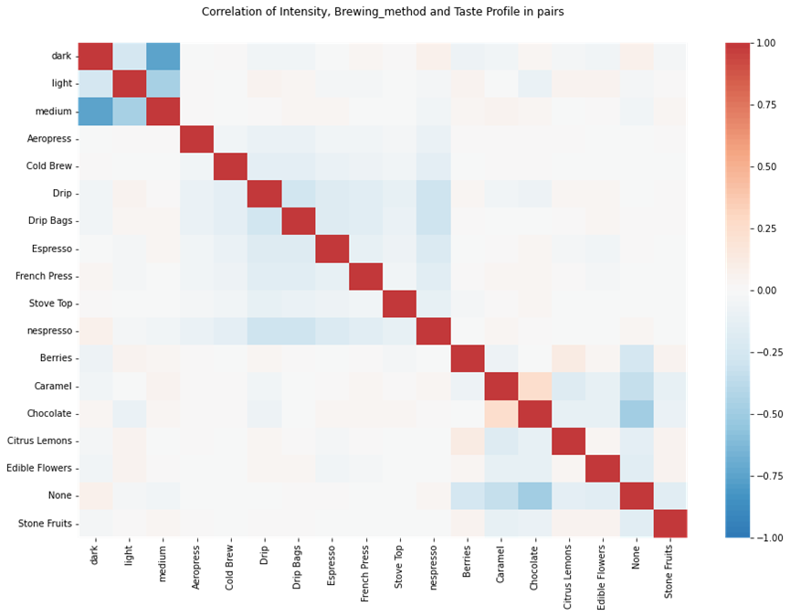
Vague Public Preferences
Correlation Analysis:
lack of links
The weak link between coffee intensity, taste and brewing method shows that it is hard to find or define a very clear public preference

Slide 10
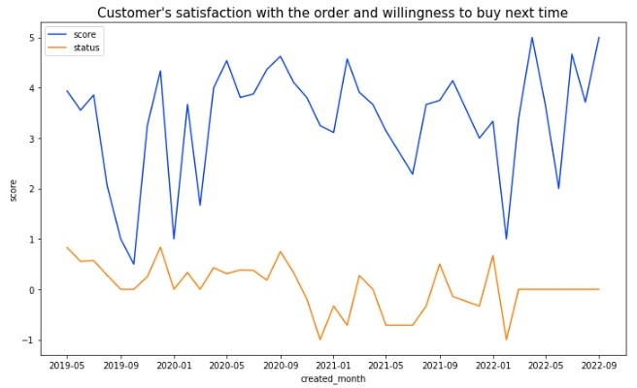
Customer Satisfaction: Limited Improvement
Review Analysis:
Because the amount of review data is small, the curve fluctuates greatly
Recent customer service satisfaction has improved slightly
Evaluation of recommendation systems tends to be moderate

Slide 11
PART 03
MODELS & RESULTS

Slide 12
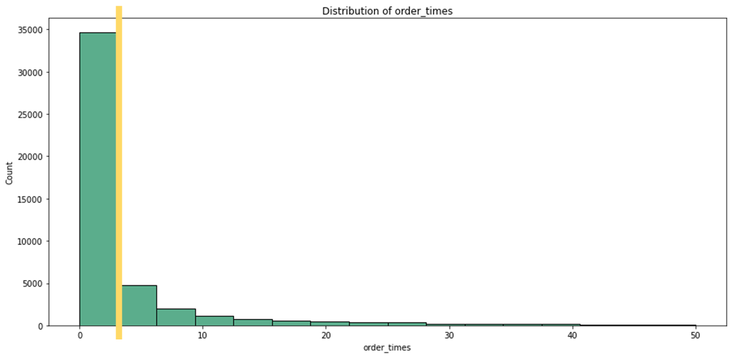
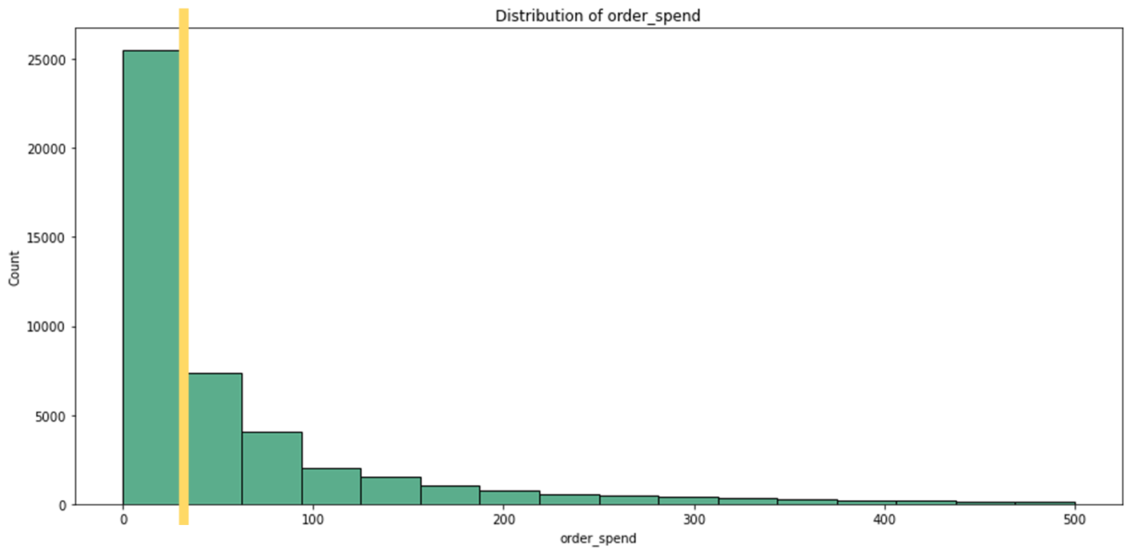
Features with Long Tail Distribution for Clustering
Each Customer Status:
record basic information
order_times: number of orders
order_spend: total consumption
total_comment: number of comments
sub_times: number of subscriptions
cancelled_times: number of canceled subscriptions

Slide 13
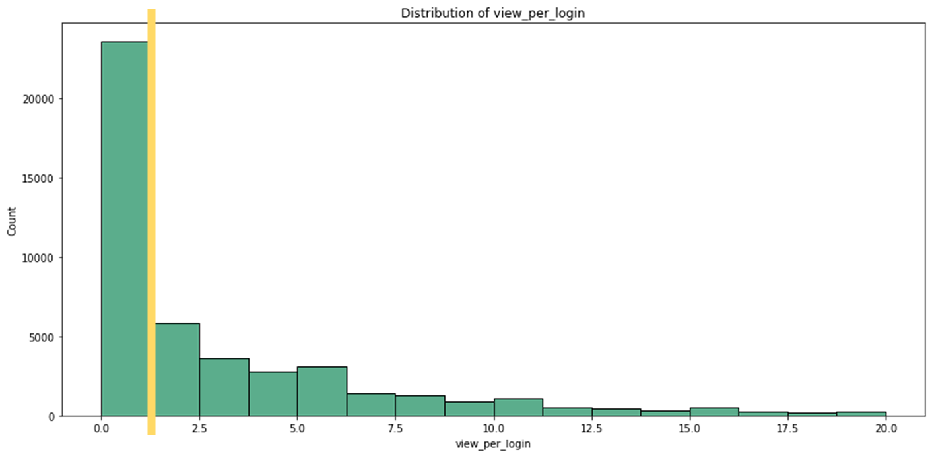
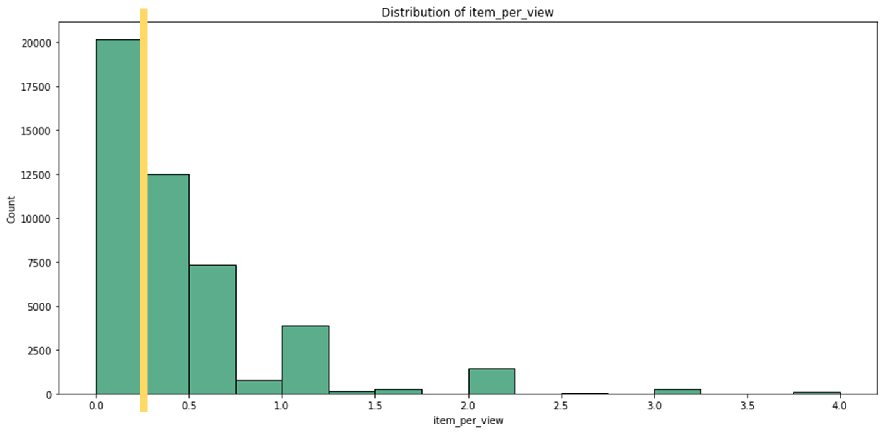
Features with Long Tail Distribution for Clustering
Each Customer Behavior:
reflect shopping characteristics
view_per_login: view times / login times
item_per_view: add cart times / view times
points_per_add: points add times / add cart times

Slide 14
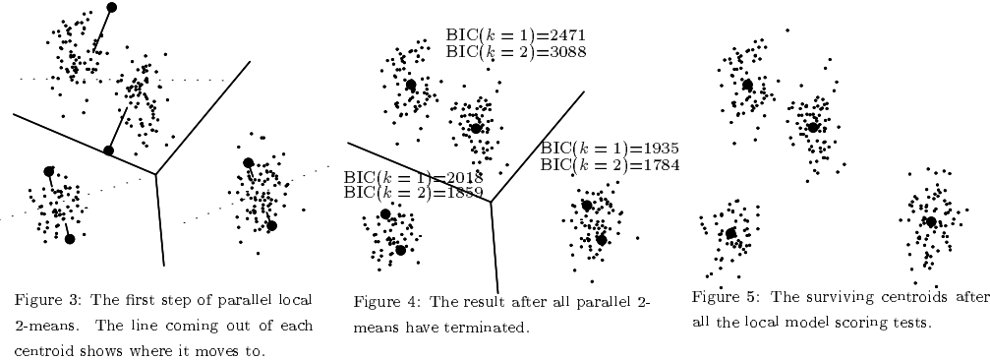
X-Means Model for Clustering
Flow Chart:
Features:
order_times
order_spend
total_comment
sub_times
cancelled_times
view_per_login
item_per_view
points_per_add
Data Standardization:
x - mean /
standard deviation
X-Means Algorithm:
BIC score
Advantage:
Better performance
No prerequisite value k
Fast

Slide 15
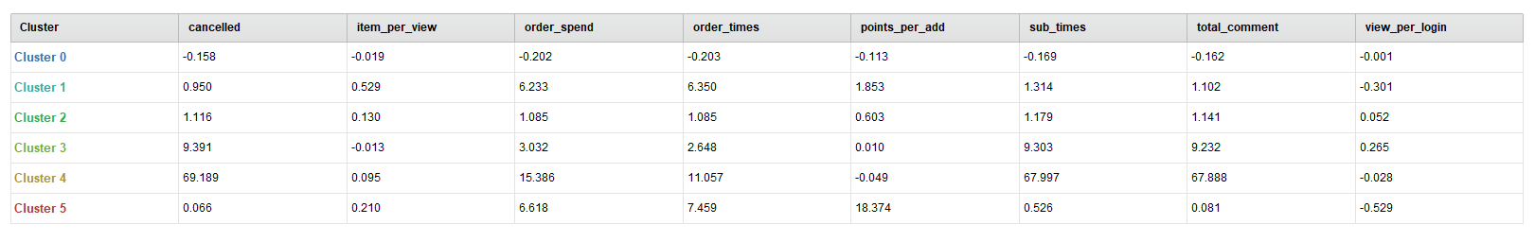
Cluster 0 aka Occasional Visitors
Low view_per_login & item_per_view: Little interest in commodities
Low order_times & order_spend & sub_times: Rarely spend money on coffee
Taking up the largest majority of customers

Slide 16
Result: 5 clusters
Cluster | Customers | Name | Main Characteristic
0 | 42310 | Occasional Visitors | Hardly login and view commodity, rarely buy goods and give feedback
1 | 504 | Curious Taster | Generate interest in a huge part of products they see and make purchase, spending more money
2 | 3997 | Prudent Buyers | Compare repeatedly before buying and spend less money
3 | 165 | Loyal Fans | Long-term subscript, spend more money
4 | 81 | Precise Hunters | Accurately discover interest from a large number of products and purchase them with a high probability

Slide 17
Cluster 1 aka Curious Taster
High item_per_view & points_per_add: Higher tendency to be interested in the goods they see and make a purchase
High order_times & order_spend: Loved spending money on coffee
Low sub_times: Interests change frequently

Slide 18
Cluster 2 aka Prudent Buyers
Low item_per_view & points_per_add:
Browse a lot of products and compare them repeatedly before buying
Slightly lower order_times & order_spend: Less money can be used

Slide 19
Cluster 3 aka Loyal Fans
High sub_times: Making long-term subscriptions
Low item_per_view & points_per_add:
Has developed a stable taste and does not like to try fresh products

Slide 20
Cluster 4 aka Precise Hunters
Low sub_times: Prefer making single purchases than subscription
High order_times & order_spend: Loved spending money on coffee
Low item_per_view & High points_per_add:
Accurately discover own interest from a large number of products and purchase them with a high probability

Slide 21
PART 04
INSIGHTS

Slide 22
Review of 5 clusters
Cluster | Customers | Name | Main Characteristic
0 | 42310 | Occasional Visitors | Hardly login and view commodity, rarely buy goods and give feedback
1 | 504 | Curious Taster | Generate interest in a huge part of products they see and make purchase, spending more money
2 | 3997 | Prudent Buyers | Compare repeatedly before buying and spend less money
3 | 165 | Loyal Fans | Long-term subscript, spend more money
4 | 81 | Precise Hunters | Accurately discover interest from a large number of products and purchase them with a high probability

Slide 23
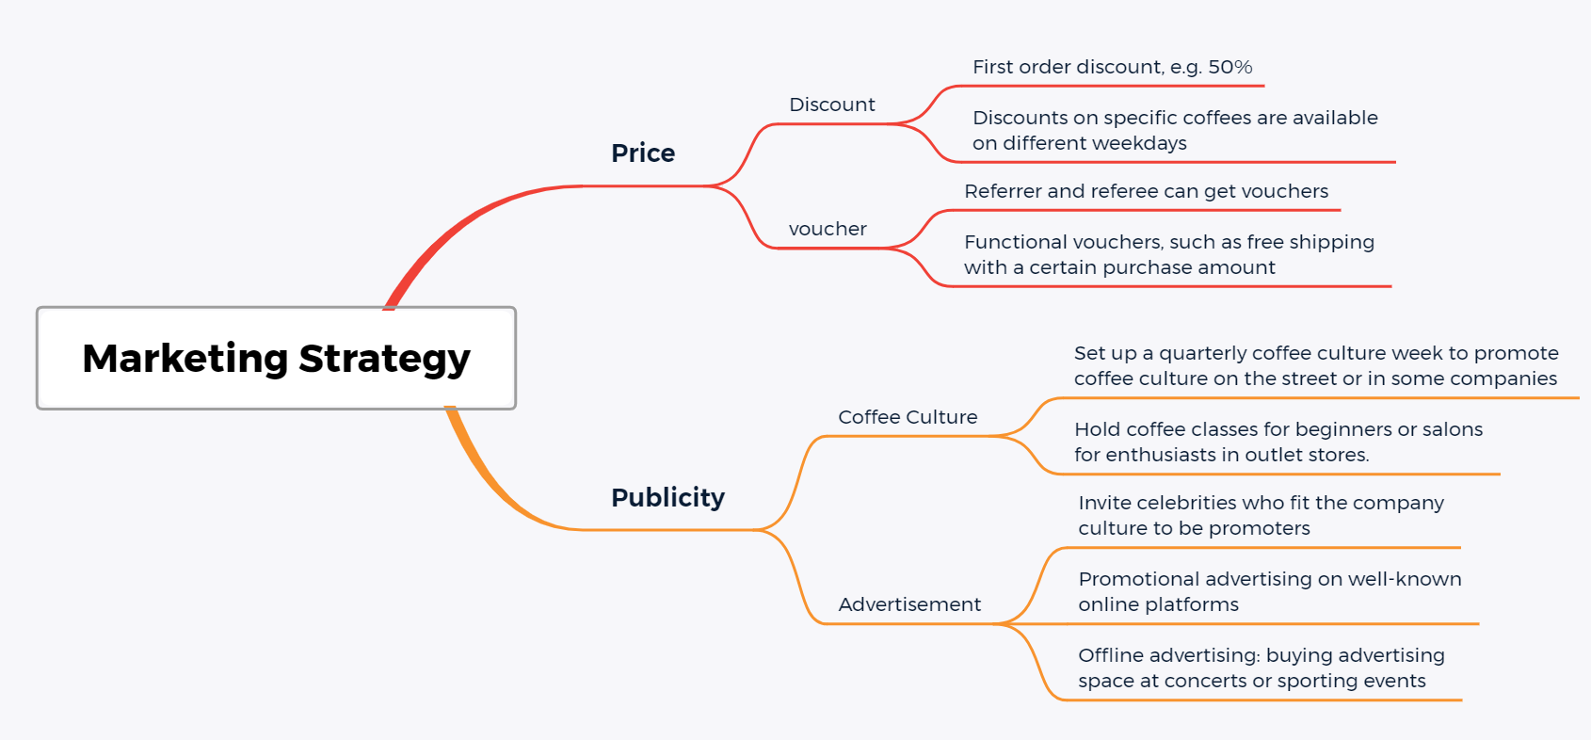
Cluster 0 aka Occasional Visitors(the largest group)

Slide 24
Review of 5 clusters
Cluster | Customers | Name | Main Characteristic
0 | 42310 | Occasional Visitors | Hardly login and view commodity, rarely buy goods and give feedback
1 | 504 | Curious Taster | Generate interest in a huge part of products they see and make purchase, spending more money
2 | 3997 | Prudent Buyers | Compare repeatedly before buying and spend less money
3 | 165 | Loyal Fans | Long-term subscript, spend more money
4 | 81 | Precise Hunters | Accurately discover interest from a large number of products and purchase them with a high probability

Slide 25
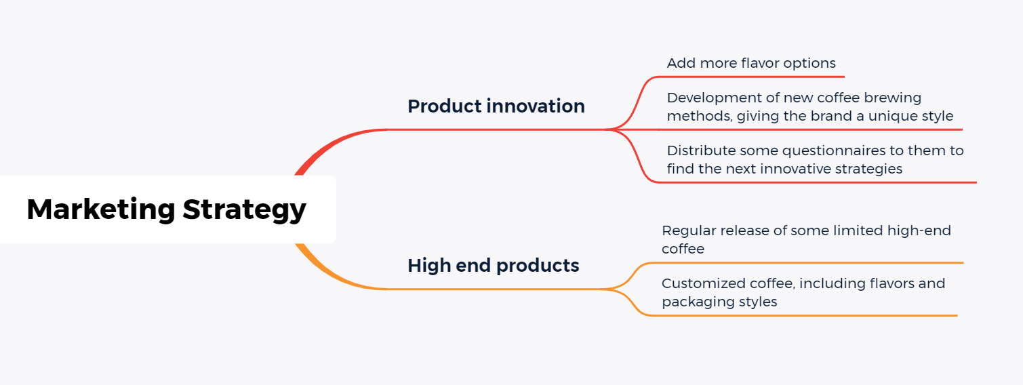
Cluster 1 aka Curious Taster

Slide 26
Review of 5 clusters
Cluster | Customers | Name | Main Characteristic
0 | 42310 | Occasional Visitors | Hardly login and view commodity, rarely buy goods and give feedback
1 | 504 | Curious Taster | Generate interest in a huge part of products they see and make purchase, spending more money
2 | 3997 | Prudent Buyers | Compare repeatedly before buying and spend less money
3 | 165 | Loyal Fans | Long-term subscript, spend more money
4 | 81 | Precise Hunters | Accurately discover interest from a large number of products and purchase them with a high probability

Slide 27
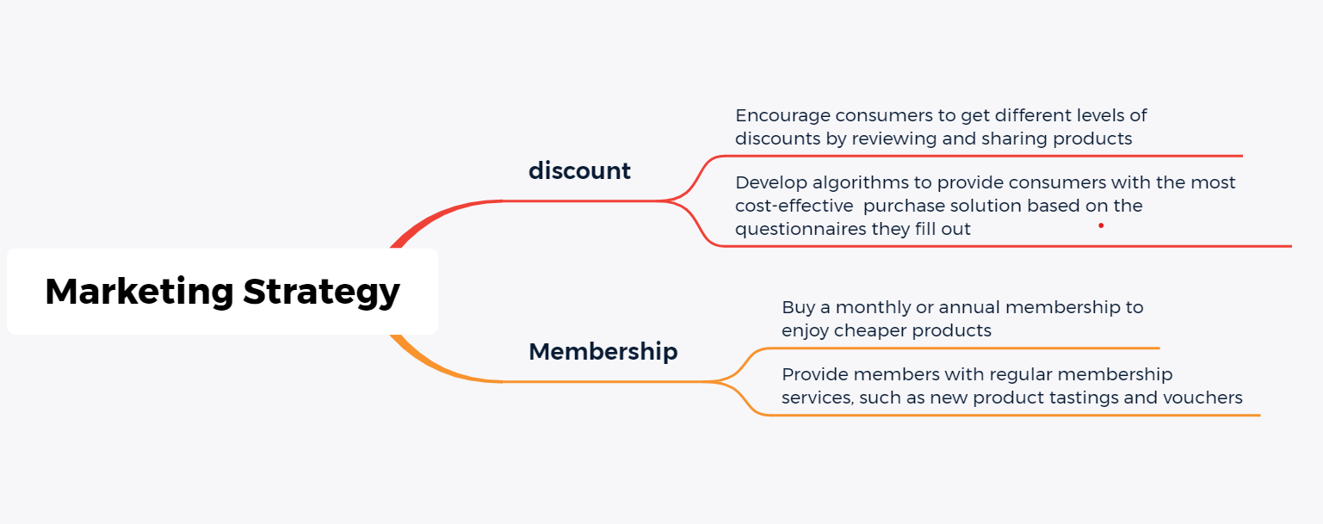
Cluster 2 aka Prudent Buyers

Slide 28
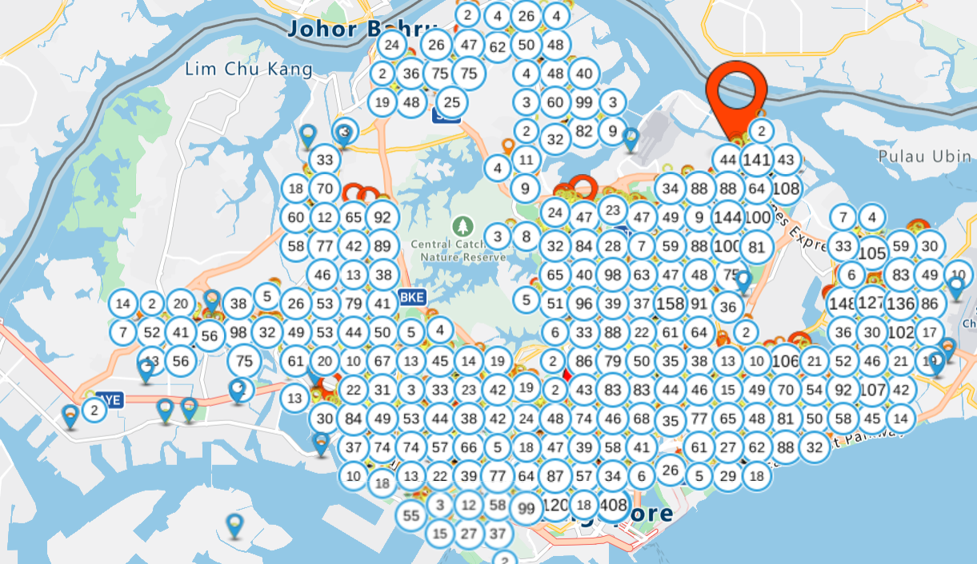
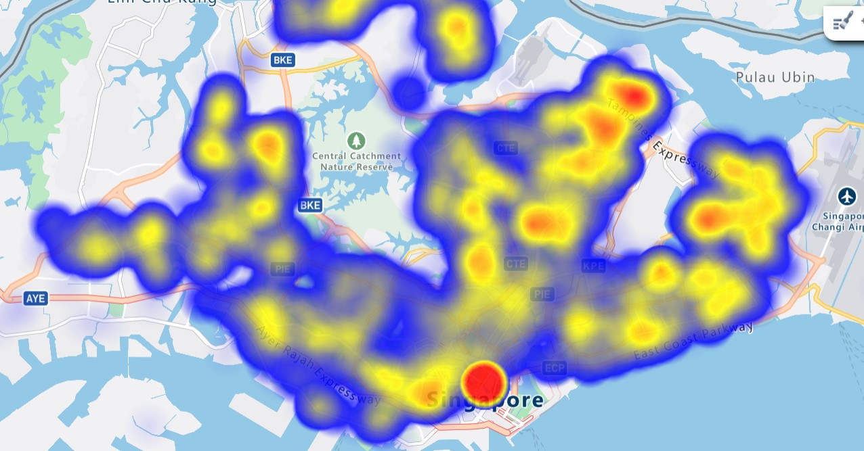
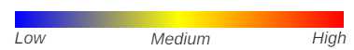
Distribution of subscribers in Singapore
Subscribers are mostly concentrated in the central and southeastern part of Singapore. Marina bay has the highest number of subscribers.
Choosing the most suitable location also requires a combination of other objective factors, such as store rent.

Slide 29
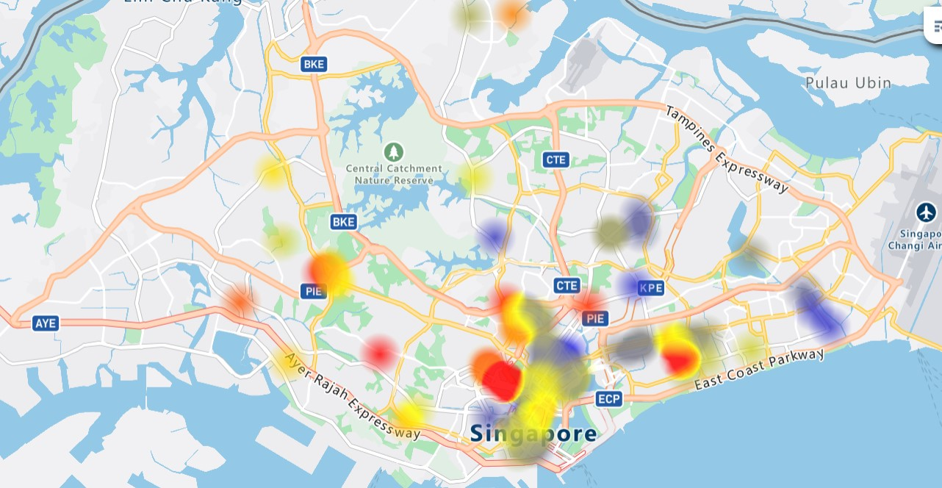
Prices of stores in different locations
Distribution of subscribers:
Prices of stores in different locations:
Potential physical outlet location:
1100 3100 5000
The largest number of customers and rents are in the upper-middle range
Medium number of potential customers and low rent fee.
The number of customers is medium, rents are low, and its product offerings can radiate to the North Central region.
The triangle structure can coordinate storage capacity and passenger flow

Slide 30
PART 05
NEXT STEP WORKS

Slide 31
A More Comprehensive Feature Set:
Better Insights and marketing strategy:
Strengthen the link between clustering result and insights
Find better insights and make better strategies based on theories and former examples in commercial field
Extract more characteristics of customers from the data to obtain a more accurate description

Slide 32
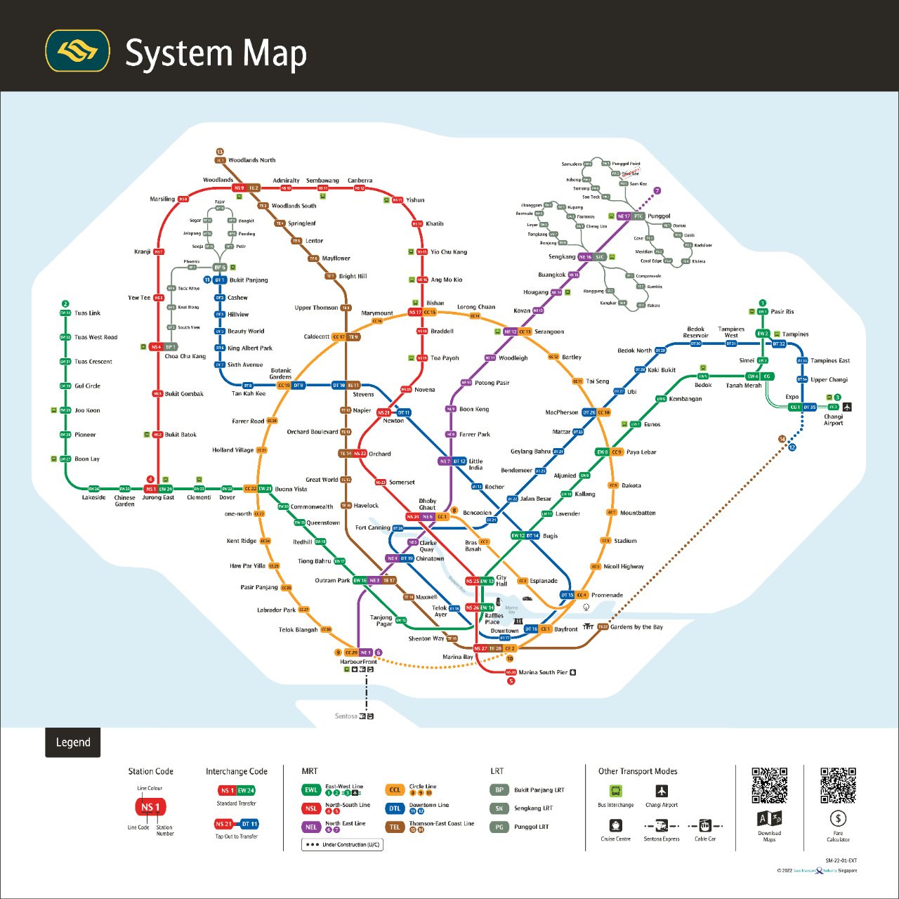
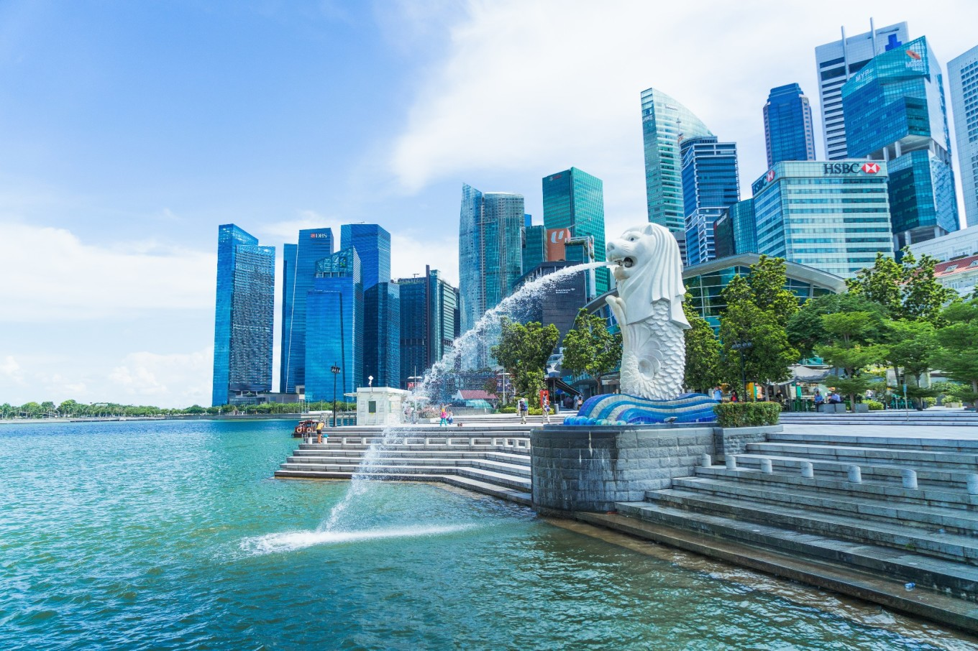
Better Outlets Location Selection:
Little information in rental fee of shops
Combine more information to find a better outlets location
e.g. Traffic and Tourist attraction

Slide 33

THANKS FOR WATCHING
Code: CaoNing-9804/MBDS_6206: User profiling analysis (github.com)

